Slide 1

IEEE WIE ILS 2026
ROUND 2 · PPT & PROTOTYPE VIDEO
IDEATE. INNOVATE. IMPACT.
POWERING SOLUTIONS. EMPOWERING WOMEN. SHAPING TOMORROW.
SheShield
It acts when she cannot.
A jewellery-style wearable that detects distress automatically, and still lets her cancel a false alarm.
Heart-rate + Motion
Confidence Score
Cancel Window
SOS
Hack Monster’z
P6 – SheShield Wearable (Hybrid)
Track 3 – SheLeads (WIE Special Track)
Marwadi University & Atmiya University, Rajkot · Round 2 · Empower to Inspire: Thriving Together for an Inclusive and Sustainable Future
Notes:
Hello judges. We are Team Hack Monster'z from Marwadi and Atmiya University, Rajkot. Our project is SheShield, a jewellery-style wearable that detects distress automatically, and lets her cancel a false alarm.

Slide 2

Team Hack Monster’z: we built every layer
Harsh Parmar
Mirali Sankaliya
Team Lead · Hardware & Firmware
SOS Integration & Documentation
Marwadi University, Rajkot
Atmiya University, Rajkot
Sensor integration: MAX30102 heart-rate + MPU6050 motion
Confidence-score logic on the ESP32
Team coordination and problem research
Cancel-window and SOS messaging logic
Testing and feedback collection
Documentation, diagrams and presentation
HOW THE WORK CONNECTS
Hardware
Firmware
Score logic
SOS + cancel
Testing
Documentation
Marwadi University & Atmiya University, Rajkot, Gujarat · IEEE WIE ILS 2026 National Hackathon · Track 3 – SheLeads
Team Lead: hp259369@gmail.com · 8401357854
IEEE WIE ILS 2026 · Hack Monster’z · SheShield
2 / 11
Notes:
I am Harsh. I built the hardware, firmware and score logic. Mirali built the cancel window, SOS messaging, testing and documentation. Together, we built every layer.

Slide 3


Problem: safety devices assume she can act
THE FAILURE POINT
Almost every safety solution needs the user to act: press a button, unlock a phone. In a real assault her hands may be restrained, or she may be in shock.
4,45,256
32%
9 of 12
7 of 12
crimes against women registered in India in 2022 (about 51 FIRs every hour)
of ever-married women (18–49) reported spousal physical, sexual or emotional violence
campus women not confident they could press a panic button if restrained or in shock
had turned off a safety app because of false alerts
NCRB, Crime in India 2022
NFHS-5, 2019–21
Our informal conversations, n = 12
Our informal conversations, n = 12
TODAY’S ASSUMPTION
She is free to act
Presses / unlocks
Alert sent
SHESHIELD’S DIFFERENCE
Distress detected
Confidence score
Alert (can cancel)
Last-mile risk Bus stop to destination: fewer people around, slowest help.
Inclusion Safety is a precondition for women’s education, work and public life.
IEEE WIE ILS 2026 · Hack Monster’z · SheShield
3 / 11
Notes:
Most safety devices need her to press a button. India recorded 4,45,256 crimes against women in 2022. In our survey of 12 women, 9 were not confident pressing a button if restrained, and 7 had switched off a safety app due to false alerts.

Slide 4




Solution: SheShield detects distress, she stays in control
WHAT IT IS
A jewellery-style wearable (bracelet / pendant concept) that detects distress automatically.
No button press to trigger. She stays in control: press to cancel, long-press for instant SOS.
01 DETECT
02 DECIDE
03 PROTECT
Heart-rate + motion, always on
Explainable 0–100 confidence score
8-second cancel window, then SOS
MAX30102 + MPU6050. No button press needed.
Heart-rate AND motion must agree. Trigger at 70.
Press to cancel. Long-press = instant SOS.
Fixes: she cannot press the button
Fixes: false alarms and alert fatigue
Phone-free in the final product (GSM)
BUILT · PROTOTYPE, shown in our video
PLANNED · FINAL PRODUCT, phone-free
Score, cancel window and long-press SOS working
SOS via Telegram over hotspot, with live GPS location
Breadboard build in a project box
Heart-rate read from the fingertip
SOS by GSM SMS: no phone or internet
Jewellery-style wearable enclosure
Wrist heart-rate, tuned in a pilot
Final product est. cost ≈ ₹2,000
IEEE WIE ILS 2026 · Hack Monster’z · SheShield
4 / 11
Notes:
SheShield detects, decides and protects. Heart-rate and motion make a zero to hundred score. At 70, an 8-second cancel window starts, then SOS goes out. A long press sends SOS instantly. Today Telegram with live GPS location; final product GSM.

Slide 5





How it works: sense, score, cancel, SOS
1 Sense
2 Score
3 Alert
4 Cancel window
5 SOS
Heart-rate + motion, always on
On-device confidence score, 0–100
Score ≥ 70: vibration + buzzer
8 s countdown. Press button = cancelled
Not cancelled: alert sent
Signal | Condition | Points
Heart-rate | Rise above her own baseline (10 s calibration): > +15 / > +25 BPM | +20 / +40
Motion | Struggle-like jerk: medium / high | +20 / +40
Rotation | Violent gyro rotation | +20
Trigger | Score ≥ 70 starts the 8-second countdown | ≥ 70
SCORE METER (0–100)
Motion 40
Rot. 20
HR 40
0
100
TRIGGER 70
Motion alone: 60 max → NO ALERT
Heart-rate and motion must agree.
10 s
baseline calibration
70
trigger threshold
8 s
cancel window
2 s
long-press SOS
Thresholds are tunable constants set by our own bench tests. No black-box AI. Planned optional 3rd signal: loud sound (MAX9814). SOS today: Telegram via hotspot + live GPS; final: GSM.
IEEE WIE ILS 2026 · Hack Monster’z · SheShield
5 / 11
Notes:
Heart-rate above her baseline gives up to 40 points, motion up to 40, rotation 20. Motion alone reaches only 60, so shaking never raises an alarm. Both signals must agree to cross 70. Every threshold is explainable.

Slide 6
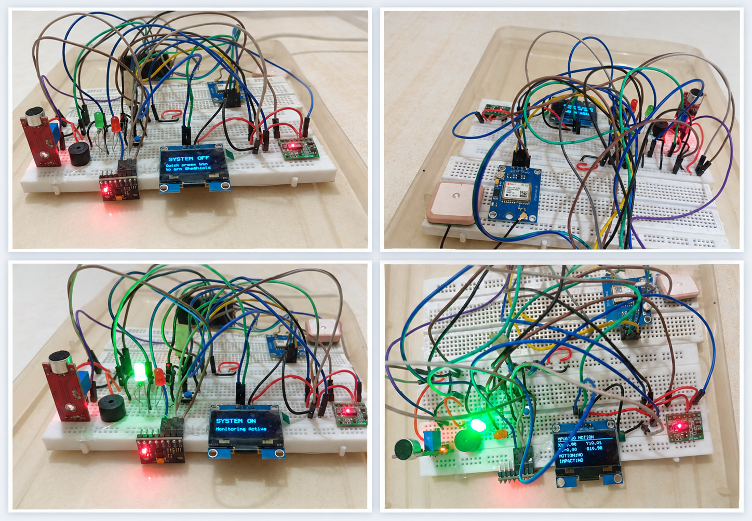

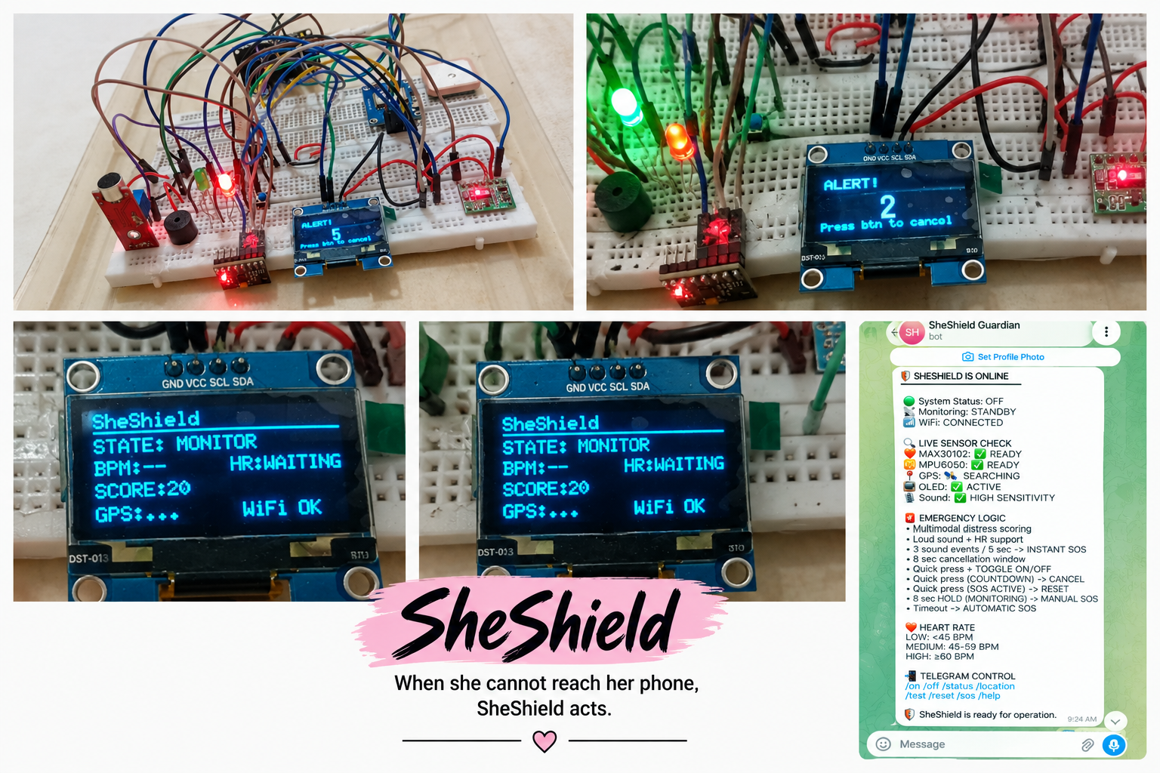
Working prototype: full loop on real hardware
✓ WORKING PROTOTYPE
FUNCTIONAL VERIFICATION: DETECTION TO ALERT
Heart-rate sensing
Motion + rotation
Confidence score
MAX30102
MPU6050
0–100, on the ESP32
Automatic trigger
8-second cancel window
Telegram SOS alert
score ≥ 70
button press
hotspot · live GPS location
2-second long-press SOS
OLED, buzzer, vibration
False-alarm control
manual, instant
live feedback
motion alone: no alert
WHAT THE PROTOTYPE PROVES
Sense → Score → Trigger → Cancel / Confirm → SOS runs end to end on hardware.
Honest scope Breadboard demo by our team, not a clinical or field study. Alert carries live GPS location (NEO-6M); next: GSM, wrist tuning. Every step is in our video.
Prototype: OLED states, countdown, Telegram bot
IEEE WIE ILS 2026 · Hack Monster’z · SheShield
6 / 11
Notes:
This is our working prototype on real hardware. Sensing, score, trigger, cancel window, long-press SOS and Telegram alert run end to end. It is a breadboard demo, and the alert carries live GPS location. Our video shows every step.

Slide 7
Innovation: two-signal score + human cancel window
Typical products | Panic-button pendants | Phone SOS apps | Shake / always-on alerts | SheShield
Needs a conscious press | Yes | Yes (unlock + tap) | Sometimes | No (manual option kept)
Needs her phone | Often | Yes | Often | Final: no. Prototype: hotspot
False-alarm control | None | Low | Low | Score + 8 s cancel window
Explainable logic | Not applicable | Not applicable | Rarely | Yes, rule-based
Columns describe typical product categories, not specific brands.
SINGLE MOST NOVEL ELEMENT
Confidence-scored multi-signal trigger
+
8-second human cancel window
+
Phone-free GSM SOS (final product)
Together they act when she cannot press a button, and keep false alarms low so contacts keep responding.
We do not claim to have invented automatic detection. What is new: passive detection combined with a user-controlled cancel window, in an explainable score.
IEEE WIE ILS 2026 · Hack Monster’z · SheShield
7 / 11
Notes:
Unlike panic pendants, phone apps and shake alerts, SheShield needs no conscious press and controls false alarms. We do not claim to invent automatic detection; our novelty is passive detection with a human cancel window.

Slide 8
Technology stack: working core + extended layer
SENSE
COMPUTE
FEEDBACK
COMMUNICATE
MAX30102 + MPU6050
ESP32 DevKit V1
OLED, buzzer, vibration
Telegram via hotspot
heart-rate + motion / rotation
score, countdown, SOS logic
button: cancel / manual SOS
today; live GPS location
NEXT · MAX9814 loud-sound signal
NEXT · GSM (phone-free)
Working prototype part | Role | Approx. cost
ESP32 DevKit V1 (30-pin) | Sensors, score, countdown, Telegram SOS | ₹300–450
MAX30102 | Heart-rate spike sensing | ₹120–200
MPU6050 (GY-521) | Struggle / jerk / rotation | ₹80–130
0.96″ OLED SSD1306 | Live BPM, score, countdown | ₹150–200
Buzzer + vibration motor | Alert; 2N2222 / BC547 + 1N4007 driver | ₹55
Button, LED, resistors | Cancel / manual SOS, status light | ₹25
Breadboard, jumpers, case | Wiring + box (USB power bank: own) | ₹150–350
PROTOTYPE COST
≈ ₹900–1,400
SOFTWARE
Arduino framework (C/C++) + open-source libraries
Telegram Bot API over HTTPS
Rule-based score, no cloud AI
EXTENDED LAYER: GPS DONE, NEXT ADD-ONS
NEO-6M GPS: live location in SOS alert (done)
MAX9814 / KY-038 (in hand): optional loud-sound signal
GSM module (planned): phone-free SOS
Prices are approximate and vary by shop.
IEEE WIE ILS 2026 · Hack Monster’z · SheShield
8 / 11
Notes:
We used ESP32, MAX30102, MPU6050, OLED, buzzer and vibration motor. Prototype cost is about 900 to 1,400 rupees. The NEO-6M GPS gives live location; next comes a GSM module.

Slide 9


Feasibility: working prototype today, pilot next
DONE — WORKING PROTOTYPE
NEXT — PLANNED
Component selection and breadboard prototype
Heart-rate and motion pipelines
Confidence score with baseline calibration
Cancel window and manual long-press SOS
OLED display and Telegram SOS
Live GPS location (NEO-6M) in the SOS alert
GSM module: phone-free SOS
Compact PCB + wearable enclosure
Minimal setup app (contacts, sensitivity)
Closed pilot, 10–15 volunteers + per-user tuning
Optional loud-sound signal (MAX9814)
TOP TECHNICAL RISK
Wrist heart-rate noise
FALSE ALARMS
Heart-rate and motion must agree, 8 s cancel, adjustable sensitivity
WEAK INDOOR SIGNAL
Final product: store-and-forward plus manual SOS
Mitigation Prototype reads the fingertip. In the pilot: per-user calibration + threshold tuning on the wrist.
PRIVACY
Processing stays on the device until an alert is confirmed
IEEE WIE ILS 2026 · Hack Monster’z · SheShield
9 / 11
Notes:
The core is done. Next: GSM, compact PCB, wearable enclosure, and a pilot with 10 to 15 volunteers. Our main risk is wrist heart-rate noise, reduced by per-user tuning.

Slide 10

Expected impact: pilot targets, not results
YEAR-1 TARGET — NOT YET ACHIEVED
500–2,000 devices
through college partnerships and IEEE WIE chapters
PILOT KPI TARGETS — GOALS FOR THE PLANNED PILOT, NOT RESULTS
TARGET
TARGET
TARGET
TARGET
≥ 95%
≤ 5%
< 15 s
≥ 70%
Alert delivery success
False-alarm rate after tuning
Trigger to SOS received (GSM version)
Daily wear compliance
INCLUSION
Removes a real barrier to women’s education, work and public life.
SUSTAINABILITY
Low-power, repairable, modular hardware with no cloud dependency.
IEEE WIE ILS 2026 · Hack Monster’z · SheShield
10 / 11
Notes:
These are pilot targets, not results: 95 percent alert delivery, under 5 percent false alarms, SOS within 15 seconds. Year-one goal: 500 to 2,000 devices.

Slide 11
SheShield acts when she cannot.
DETECT · DECIDE · PROTECT
DETECT
DECIDE
PROTECT
Heart-rate + motion, no button press needed
Explainable 0–100 confidence score, trigger at 70
8-second cancel window, then SOS. Long-press = instant SOS
WORKING TODAY
Prototype ≈ ₹900–1,400, bench-tested, Telegram SOS + live GPS
NEXT
GSM · wearable PCB · pilot, 10–15 volunteers
Our ask Pilot partners (IEEE WIE chapters, colleges) and mentorship to harden the GSM version.
GitHub github.com/HarshParmar029/SheShield-Wearable
Demo video https://drive.google.com/file/d/1BlsPJShyzV3eILE0zheHAcHvunwJRicK/view?usp=sharing
Thank you · Team Hack Monster’z · Marwadi University & Atmiya University, Rajkot
11 / 11
Notes:
SheShield acts when she cannot. We seek pilot partners and mentorship for the GSM version. Our code is on GitHub. Thank you.

